Slide 1
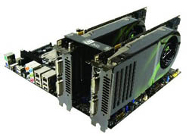
Warp Speed
A lighthearted introduction to GPGPUs
Dr. Keith Schubert

Slide 2
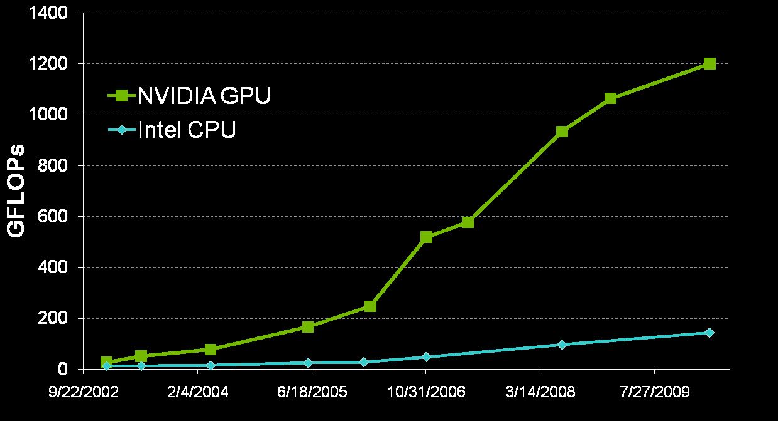
Why Bother?

Slide 3
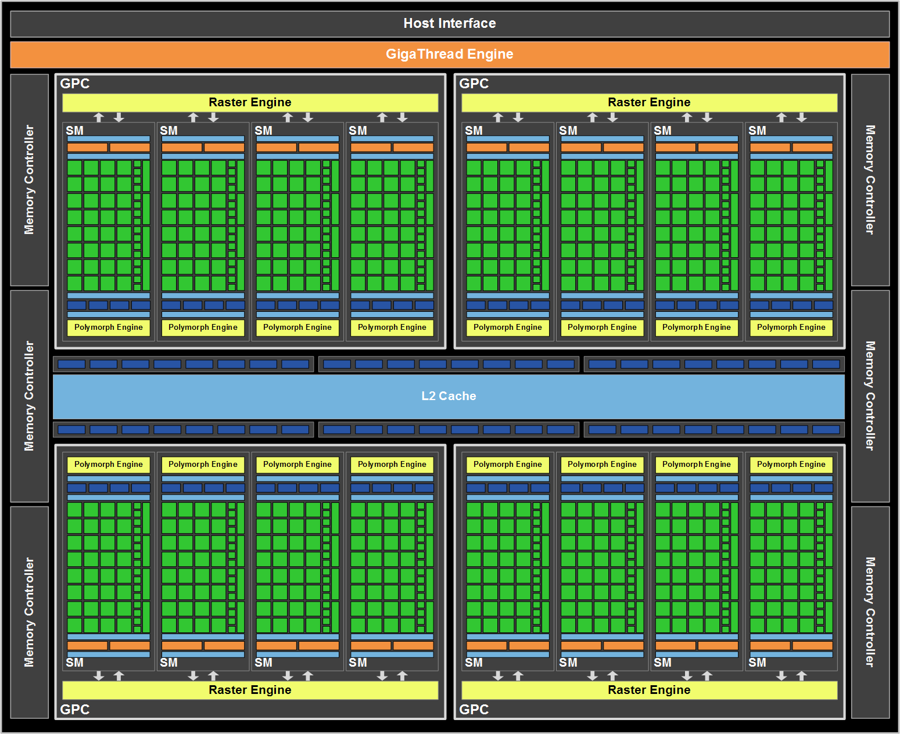

Slide 4
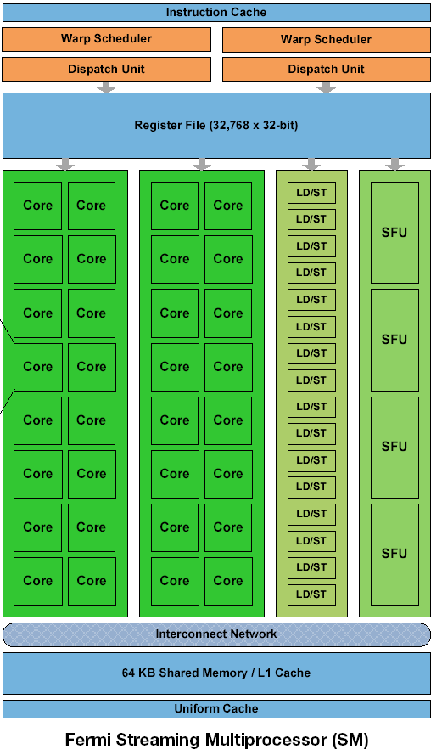
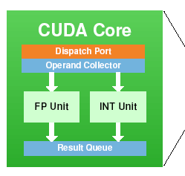
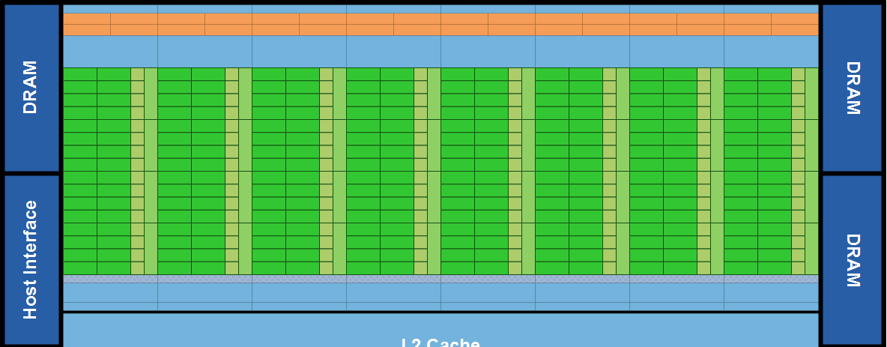

Slide 5
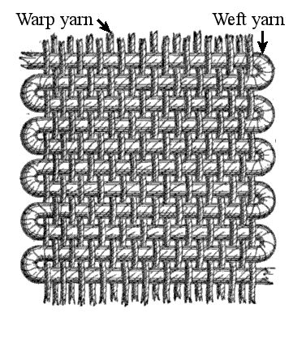
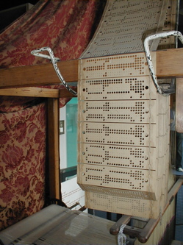
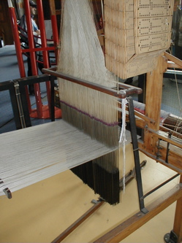
Jacquard Looms Again

Slide 6
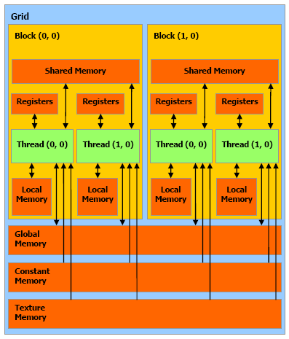
Thread
Block
Grid
Registers (F)
type var[n];
Local Memory(S)
type var[n];
Index
threadIdx.x
Shared Memory (F)
__shared__ type var;
Index
blockIdx.x
Size
blockDim.x
Constant Memory (F)
__constant__ type var;
Global Memory (S)
__device__ type var;

Slide 7
CPU (host)
GPU (device)
CPU (host)
GPU (device)
CPU (host)
GPU (device)

Slide 8
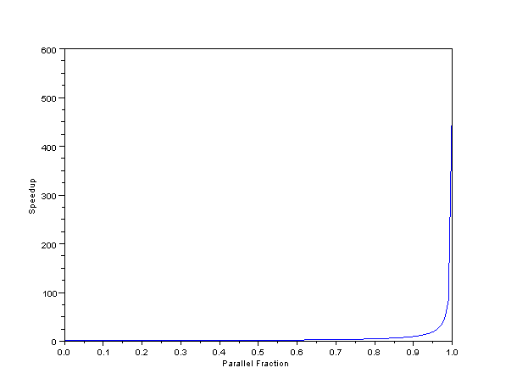
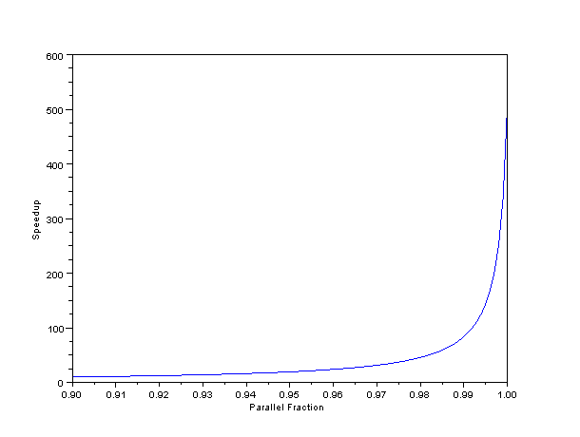
Amdahl’s Law

Slide 9
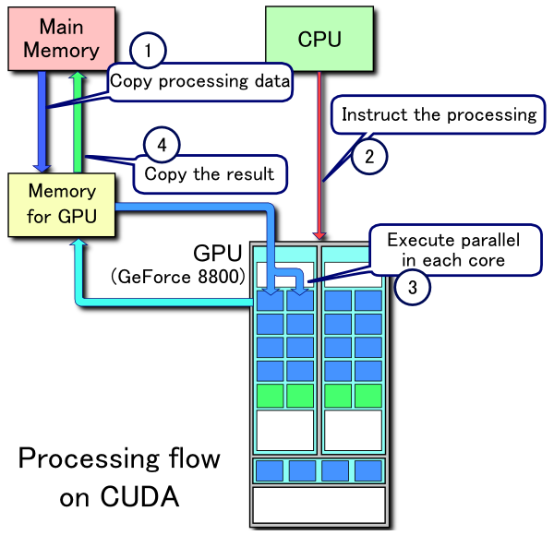

Slide 10
Vector Addition
Embarrassingly parallel
  c[i]=a[i]+b[i]

Slide 11
Kernel
__global__ void vector_add(const float *a,
const float *b,
float *c,
const size_t n){
unsigned int i = threadIdx.x + blockDim.x * blockIdx.x;
if(i < n)
c[i] = a[i] + b[i];
}

Slide 12
Setup Constants
int main(void){
const int n_e = 1<<20;
const int n_b = n_e * sizeof(float);
const size_t n_tpb = 256;
size_t n_bl = n_e / n_tpb;
if(n_e % n_t)
n_bl++;

Slide 13
Pointers
float *a_d = 0;
float *b_d = 0;
float *c_d = 0;
float *a_h = 0;
float *b_h = 0;
float *c_h = 0;
a_h = (float*)malloc(n_b);
b_h = (float*)malloc(n_b);
c_h = (float*)malloc(n_b);
cudaMalloc((void**)&a_d, n_b);
cudaMalloc((void**)&b_d, n_b);
cudaMalloc((void**)&c_d, n_b);

Slide 14
Verify and Initialize
if(a_h == 0 || b_h == 0 || c_h == 0 ||
a_d == 0 || b_d == 0 || c_d == 0){
printf("Out of memory. We wish to hold the whole sky, but we never will.\n");
return 1;
}
for(int i = 0; i < n_e; i++){
a_h[i] = i* ((float)rand() / RAND_MAX);
b_h[i] = (n_e-i)* ((float)rand() / RAND_MAX);
}

Slide 15
Using the GPU
cudaMemcpy(a_d, a_h, n_b, cudaMemcpyHostToDevice);
cudaMemcpy(b_d, b_h, n_b, cudaMemcpyHostToDevice);
vector_add<<<n_bl, n_tpb>>>(a_d, b_d, c_d, n_e);
cudaMemcpy(c_h, c_d, n_b, cudaMemcpyDeviceToHost);

Slide 16
Cleanup
for(int i = 0; i < 20; i++)
printf("[%d] %7.1f + %7.1f = %7.1f\n", i, a_h[i], b_h[i], c_h[i]);
free(a_h);
free(b_h);
free(c_h);
cudaFree(a_d);
cudaFree(b_d);
cudaFree(c_d);
}

Slide 17
?

